Slide 1


Enhancing Sustainable Crop Protection through Machine Learning-Driven Integrated Strategies
TMP – 2023-24-074

Slide 2


Supervisor : Mr. Vishan Jayasinghearachchi
Co-Supervisor : Mr. Samadhi Rathnayake
Team Member Name | IT Number
Senanayake P.M. | IT20606756
Withanage P.W.E.L. | IT20600334
Wijesinha W.S.S | IT20641092
Anuththara R.M.C | IT20637064

Slide 3

Introduction
Sri Lanka is very popular in the world market for Desiccated Coconut (DC) and Brown fiber. Distinguishable white color and characteristic taste of Sri Lankan DC ranks Sri Lanka at the 4th position of the world export market for all kernel products. Sri Lanka holds the global No.1 for the exports of brown fiber. The drum system used to extract fiber, produces long pure fiber, which are more suitable for the brush industry.
COCONUT
Cultivation
In Sri Lanka
Coconut accounts for approximately 12% of all agricultural produce in Sri Lanka with the total land area under cultivation covering 409, 244 hectares (2017) and about 2,500 -3000 million nuts produced per year (by 2017). New measures have been introduced to enhance the annual coconut crop to 3600 million nuts per year.

Slide 4
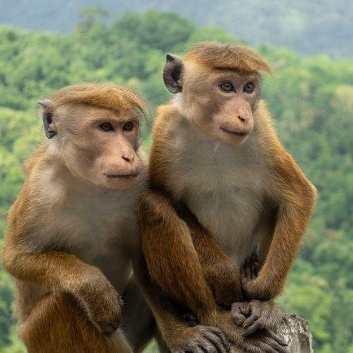
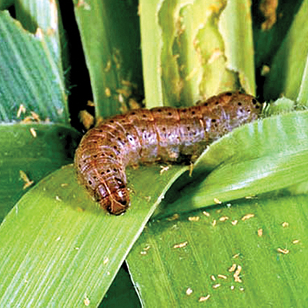
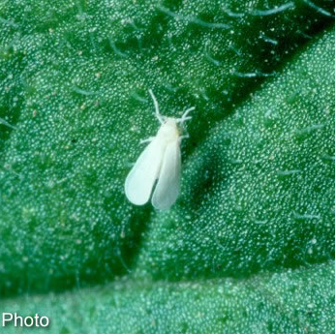
Problem
How can we
Protect
the Crop?

Slide 5
Solution
Macaque Monkey Detection
Monkey Arrival Conformation
Detect the Macaque Monkey arrival by identifying the sound.
Conform the arrival of macaque monkey using cameras.
Monkey Behavior Prediction
Minuscule Pest Detection
Content A - 40%
Predict the future behaviors of macaque monkey.
Identify the pest attacks in initial stage using images.
Content B - 70%
Content C - 30%
Coconut
Monkey
Content D - 90%

Slide 6

COMO SYSTEM

Slide 7
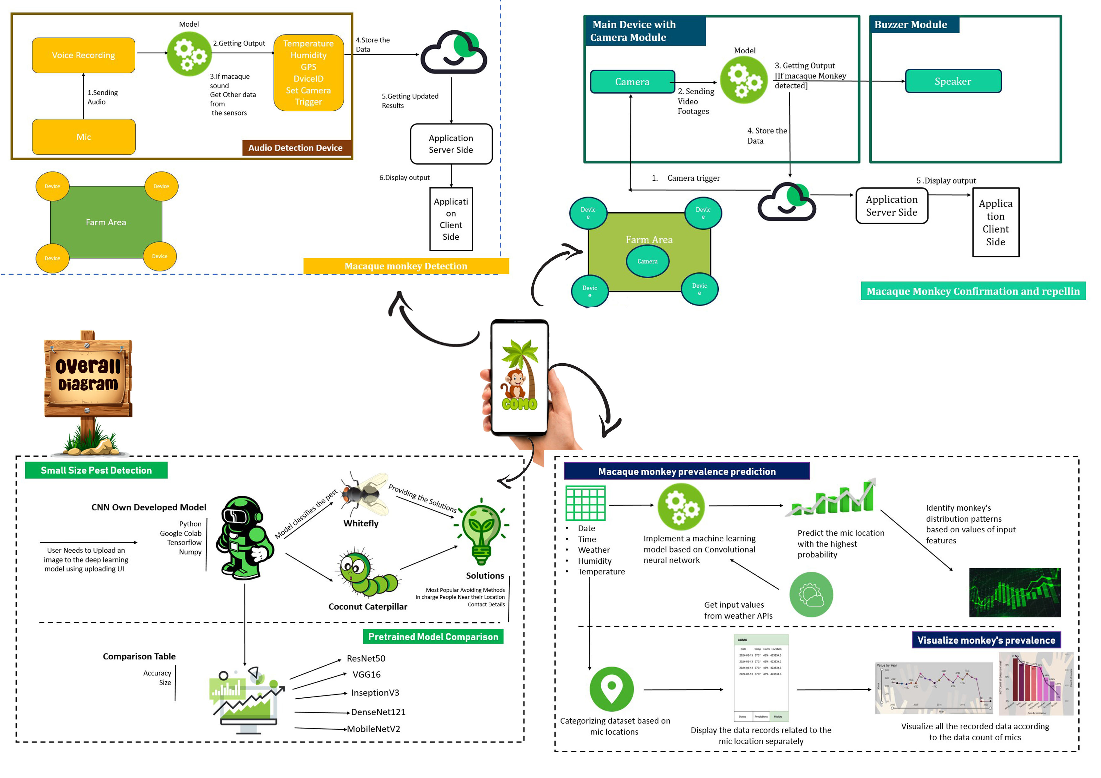
Overall Diagram

Slide 8

Macaque Monkey Detection
Wijesinha W.S.S

Slide 9
Problem
Macaque monkey can arrive any time in the day. How to identify their arrival ?
Farm area is huge. How to identify where they can present ?
How to go with sustainable product to detect and repel macaque monkey?
Solution
Use a two-factor authentication process to detect macaque monkeys.
First, analyze environmental noise, then confirm with video analysis.
When macaque monkeys arrive, they usually make sounds.
These sounds are unique and can be used to detect them. Use macaque sound to detect them
This reduces power consumption.
Cameras don't need to be on all the time.
Use more microphones and fewer cameras covering the area.
Real-time monitoring should be done with a sustainable device.
Use GPS sensors to locate microphones and identify macaque locations for future behavior analysis.

Slide 10
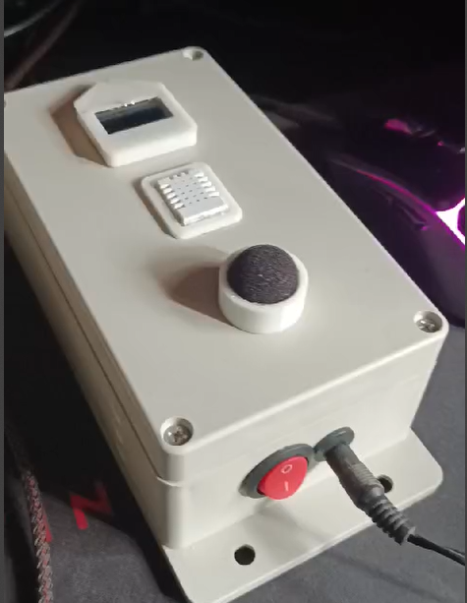
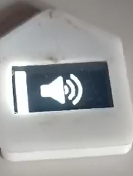
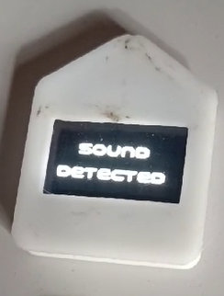
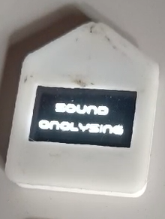
Macaque Monkey Detection

Slide 11
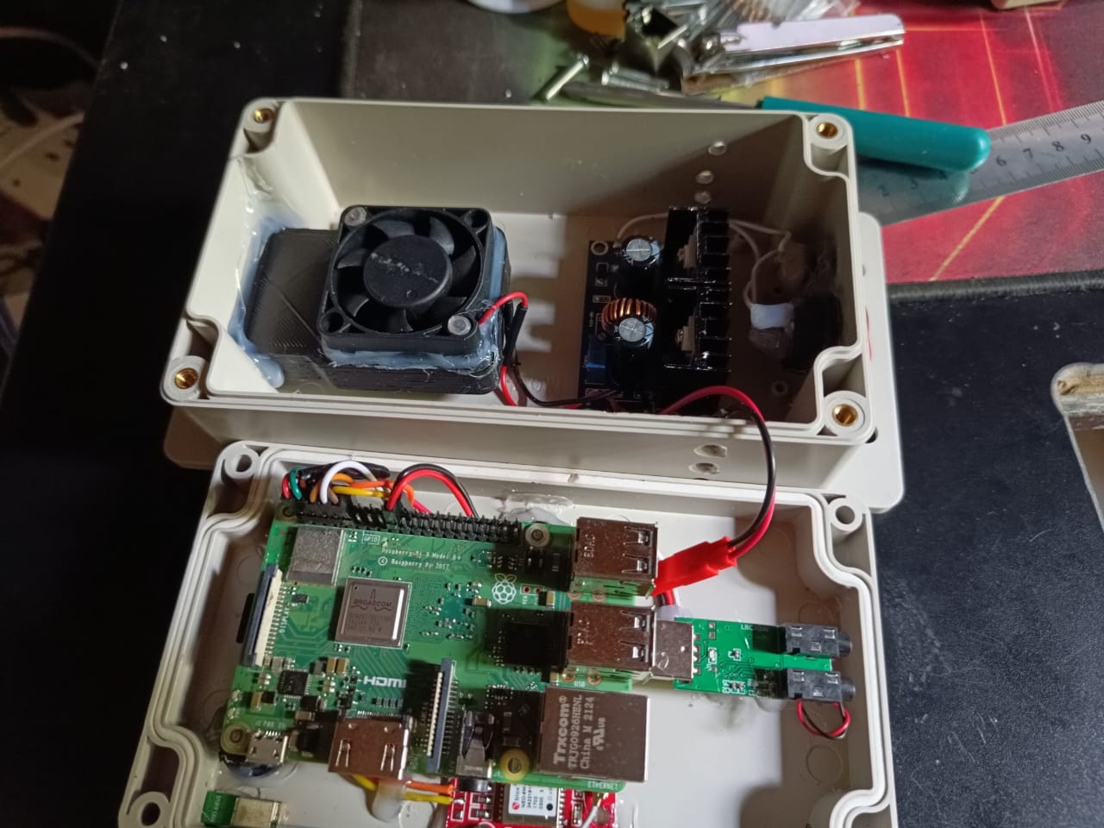
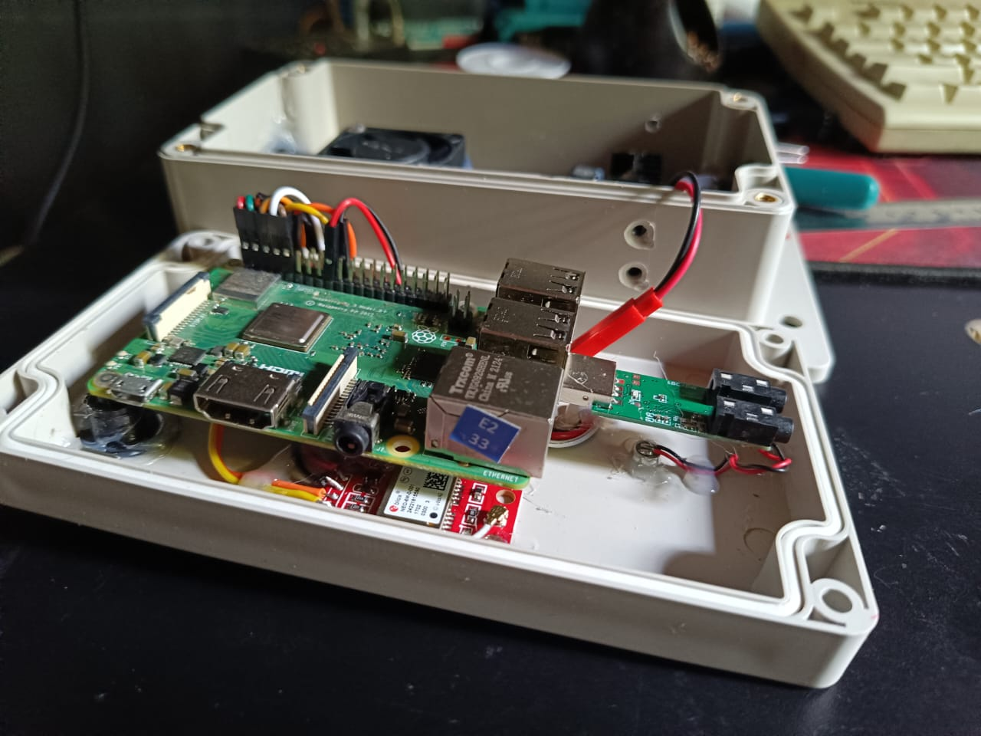
Hardware Implementation

Slide 12
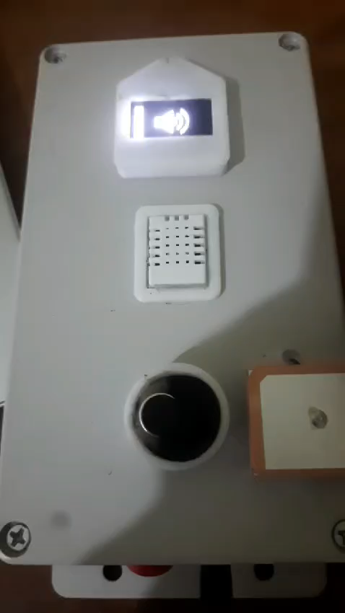
Demonstration Video

Slide 13
Testing & Results
No | Model | Avg. Accuracy
1 | RNN(LSTM) | 0.90
2 | CNN1D | 0.93

Slide 14
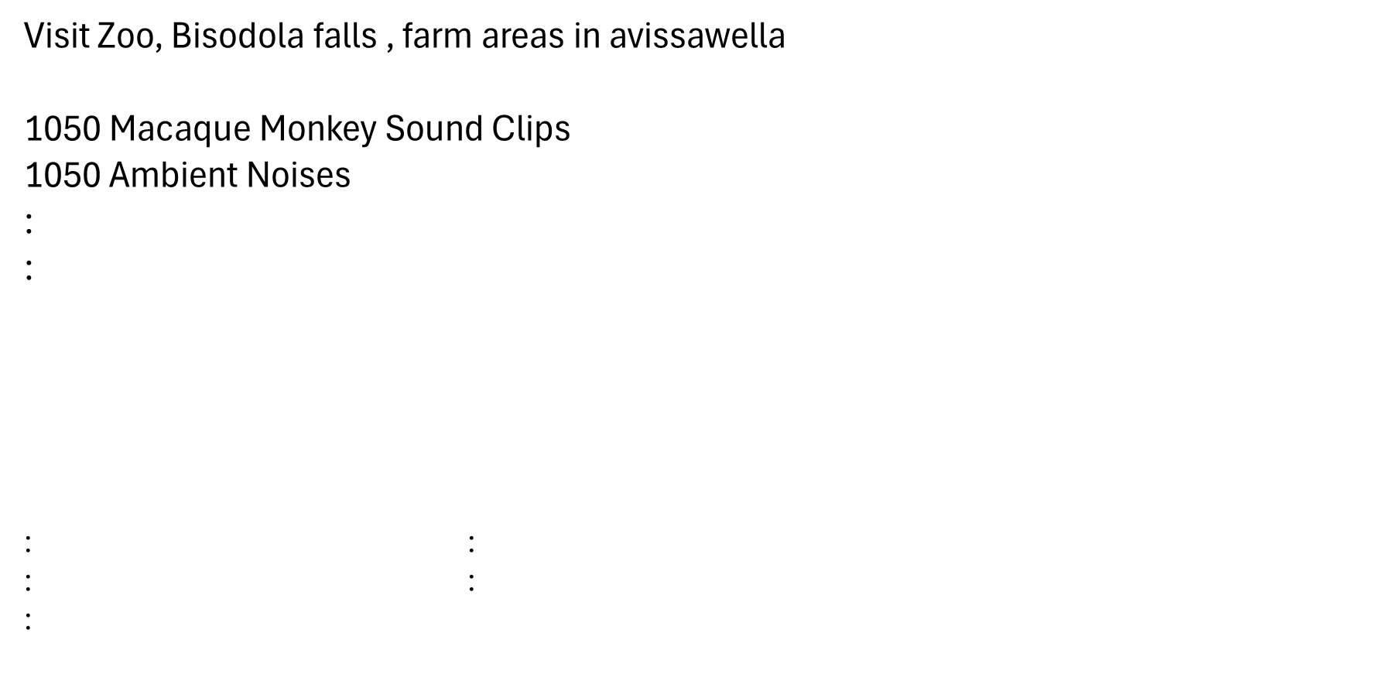
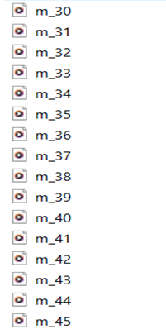
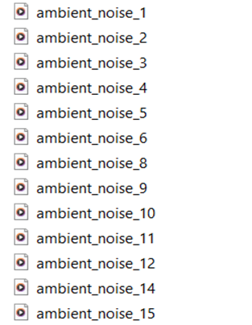
Data Collection

Slide 15

Macaque Monkey Arrival Confirmation
ANUTHTHARA R.M.C

Slide 16
Problem
When the sound of a macaque monkey is detected, how can their presence be confirmed through visible signs (such as video footage)?
How to go with sustainable product to Confirm and repel macaque monkey?
Solution
When the sound of a macaque monkey is detected, we can trigger the camera to capture video footage.
The video footage is then analyzed, and if a macaque monkey is detected, the alarm module will be triggered.
The farmer will be notified of the arrival of the macaque monkey through the mobile application
The detected monkey's image will be displayed on the mobile application.
Once the alarm goes off, videos of the current situation in the farm area will be captured and displayed on the mobile application.
The mobile application has an option to turn the alarm on or off if the farmer wants to do it manually.

Slide 17
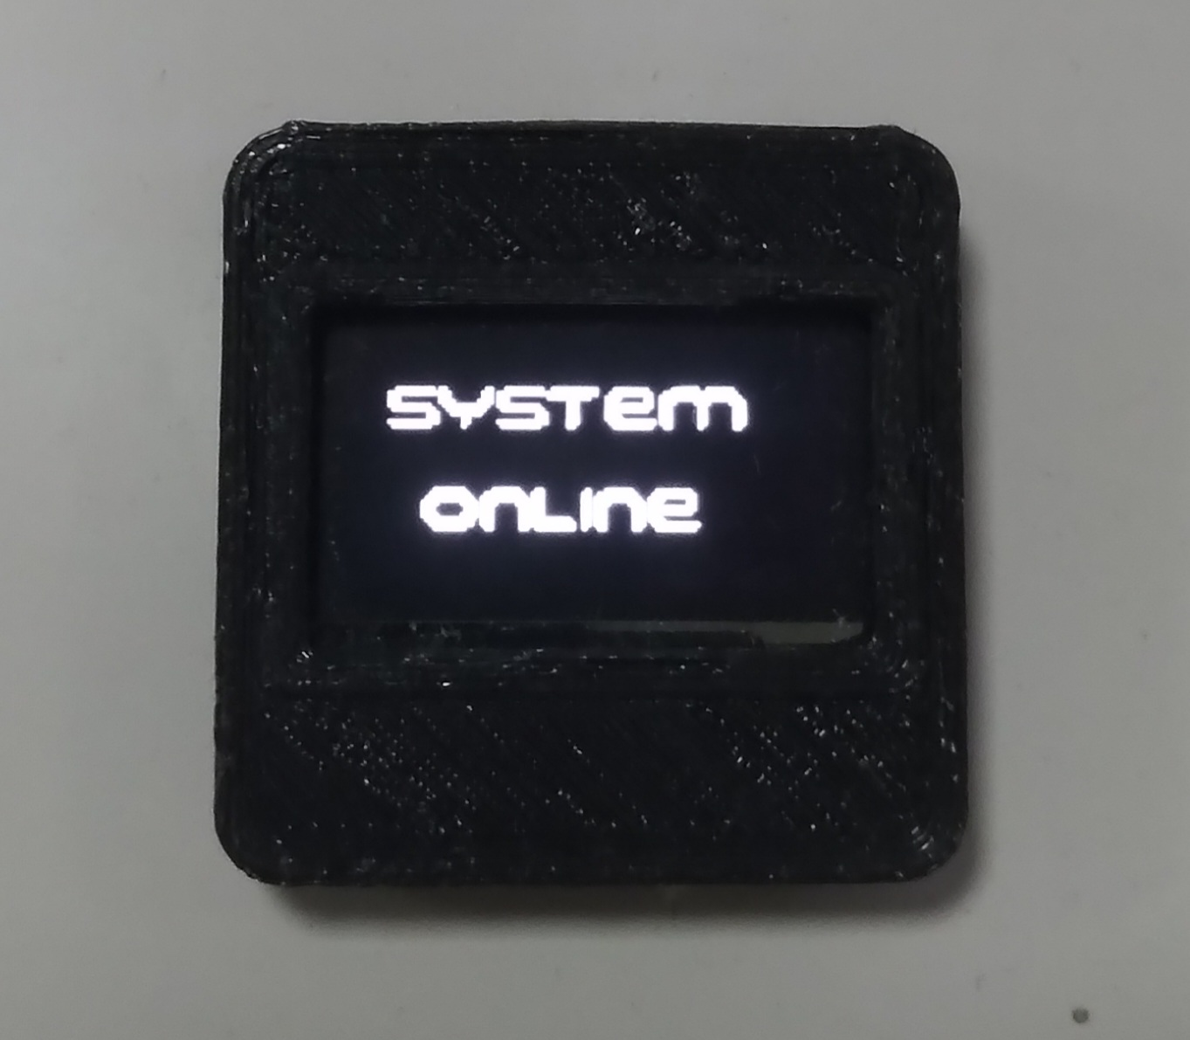
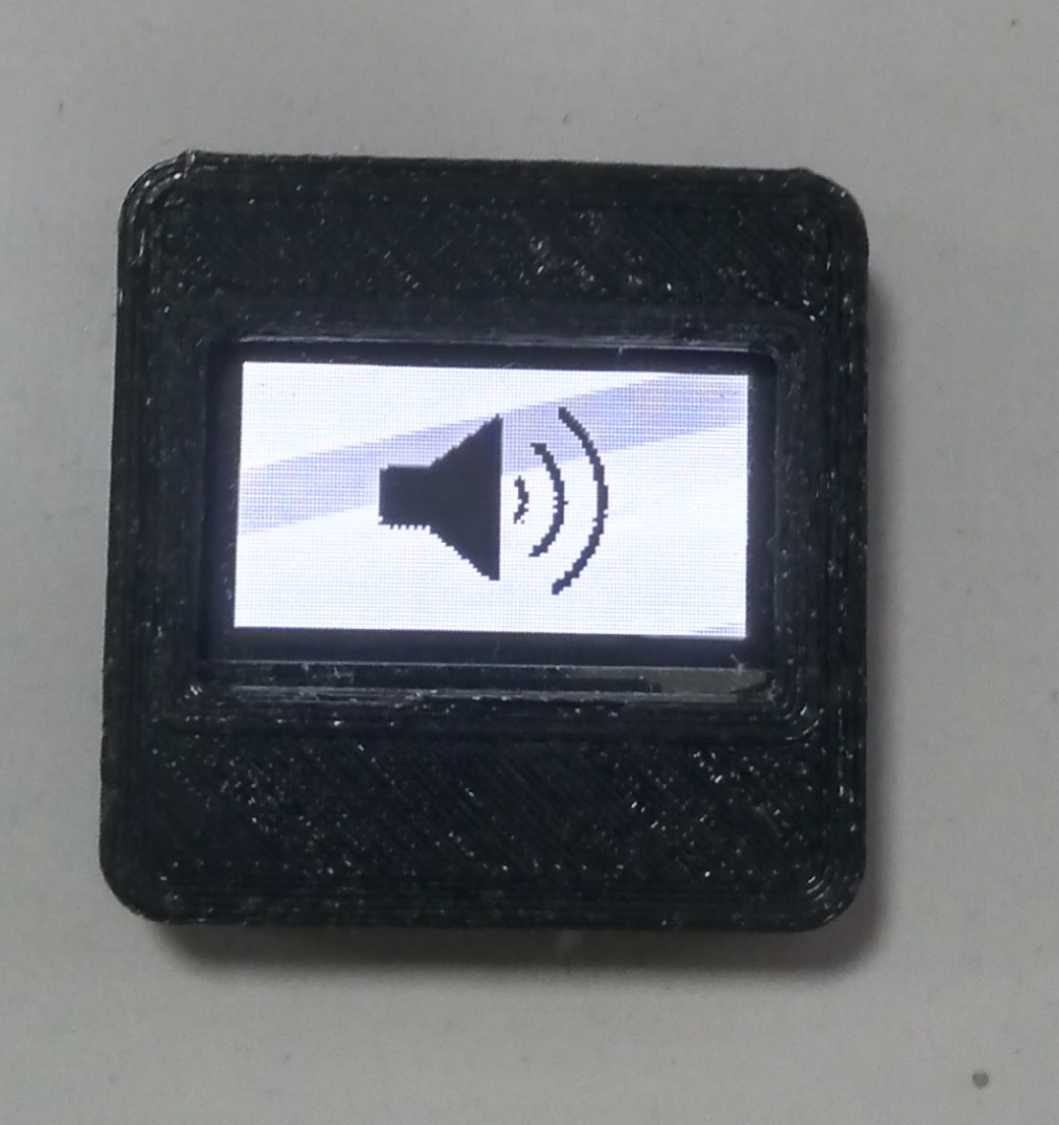

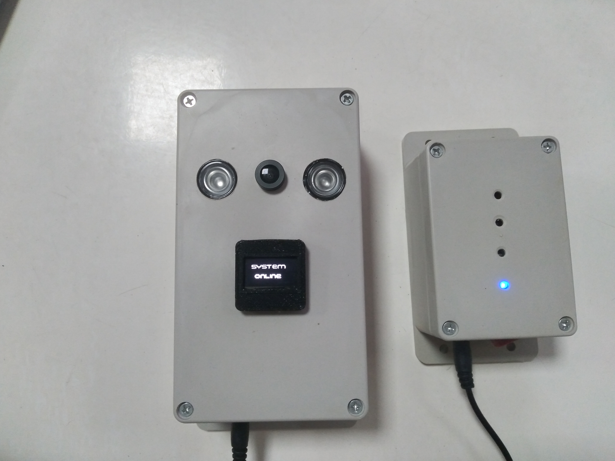
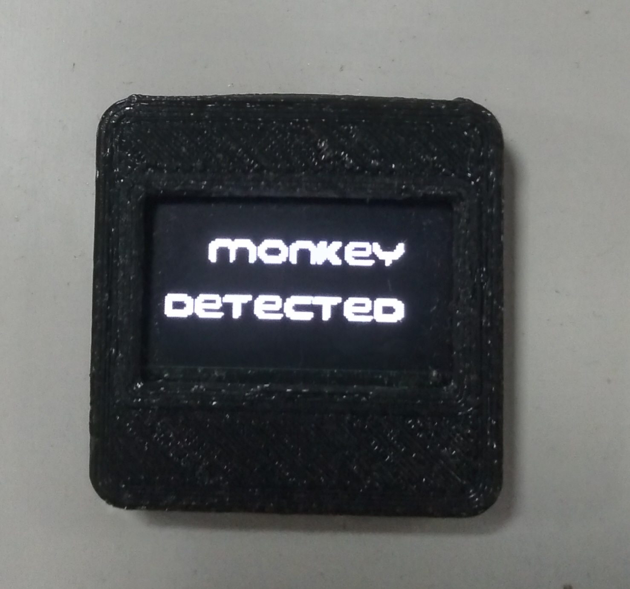
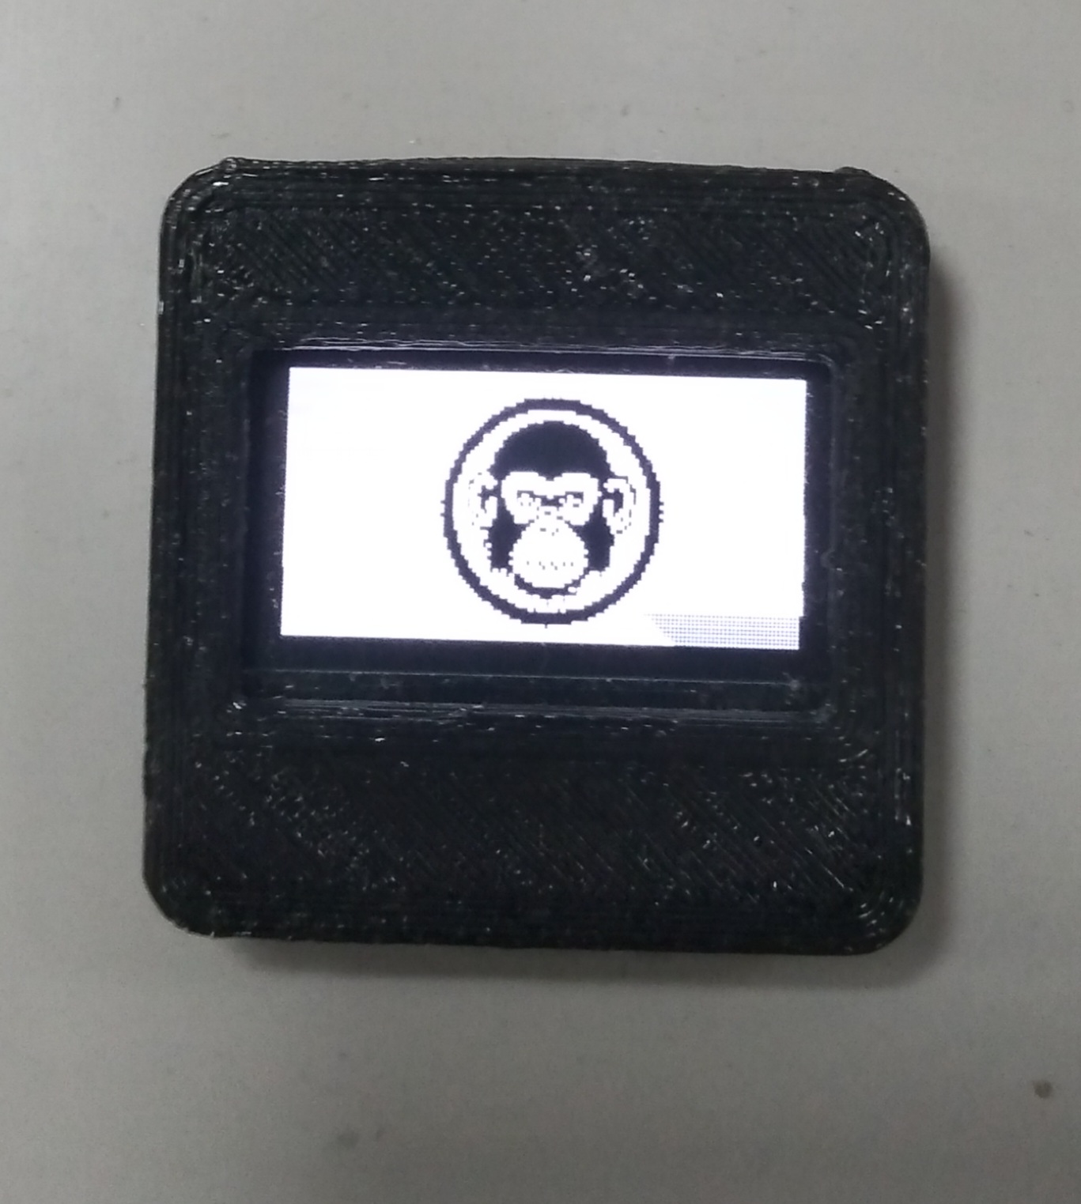
Macaque Monkey Detection

Slide 18
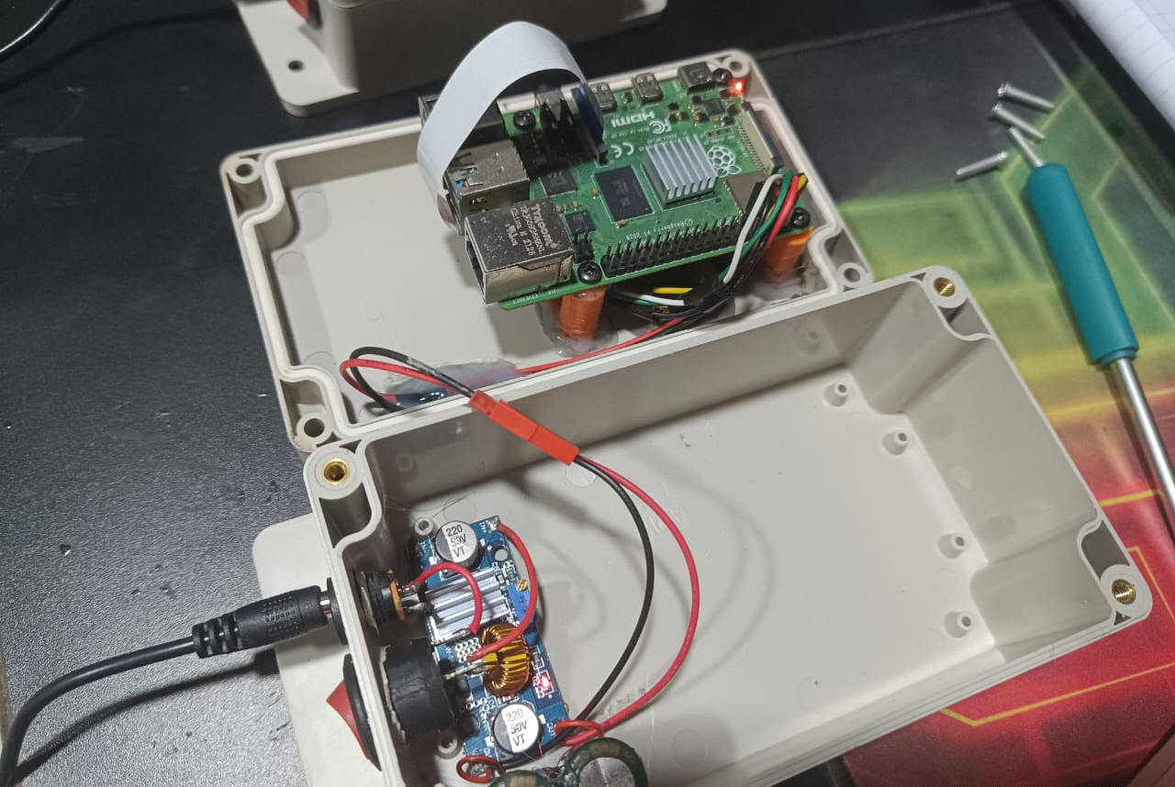
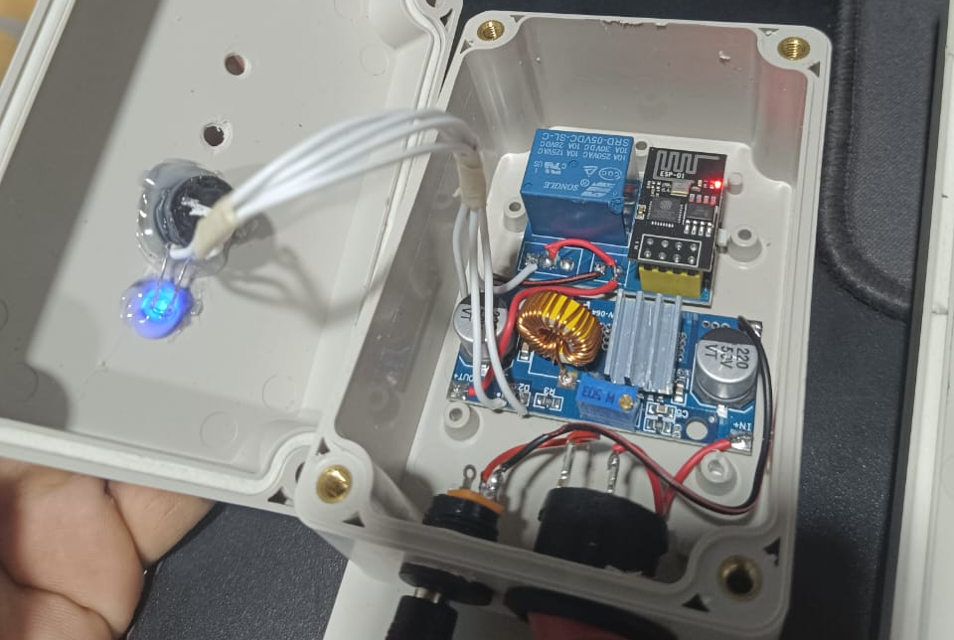
Hardware Implementation
Camera Module
Buzzer Module

Slide 19
Testing & Results
Epoch No. | Testing Accuracy | Epoch No. | Testing Accuracy
1 | 0.78 | 6 | 0.81
2 | 0.80 | 7 | 0.84
3 | 0.79 | 8 | 0.86
4 | 0.82 | 9 | 0.90
5 | 0.85 | 10 | 0.89
Average Accuracy |  | 0.83

Slide 20
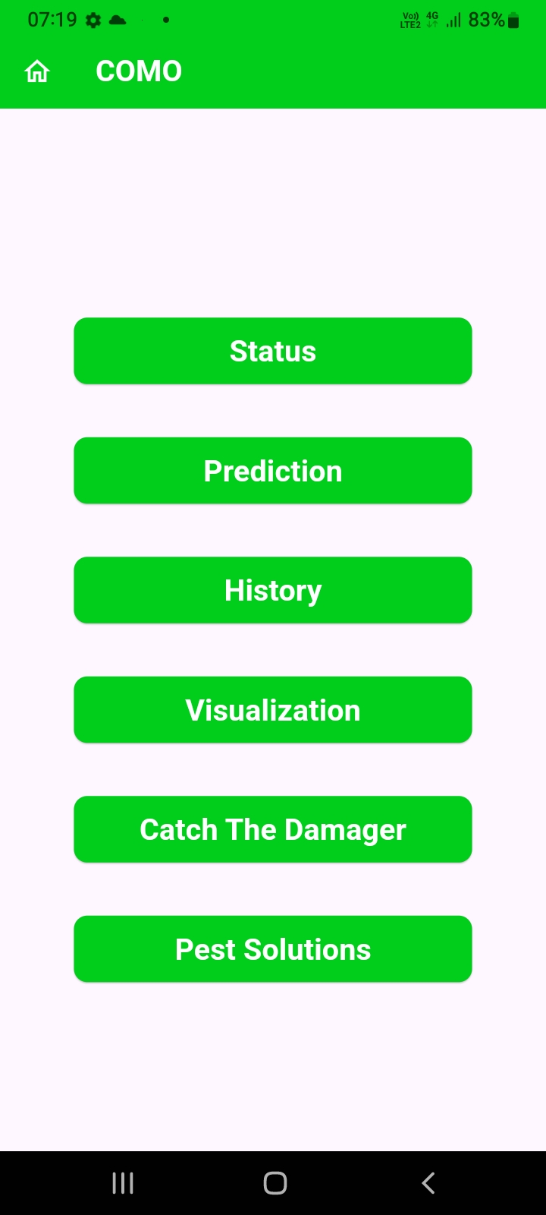
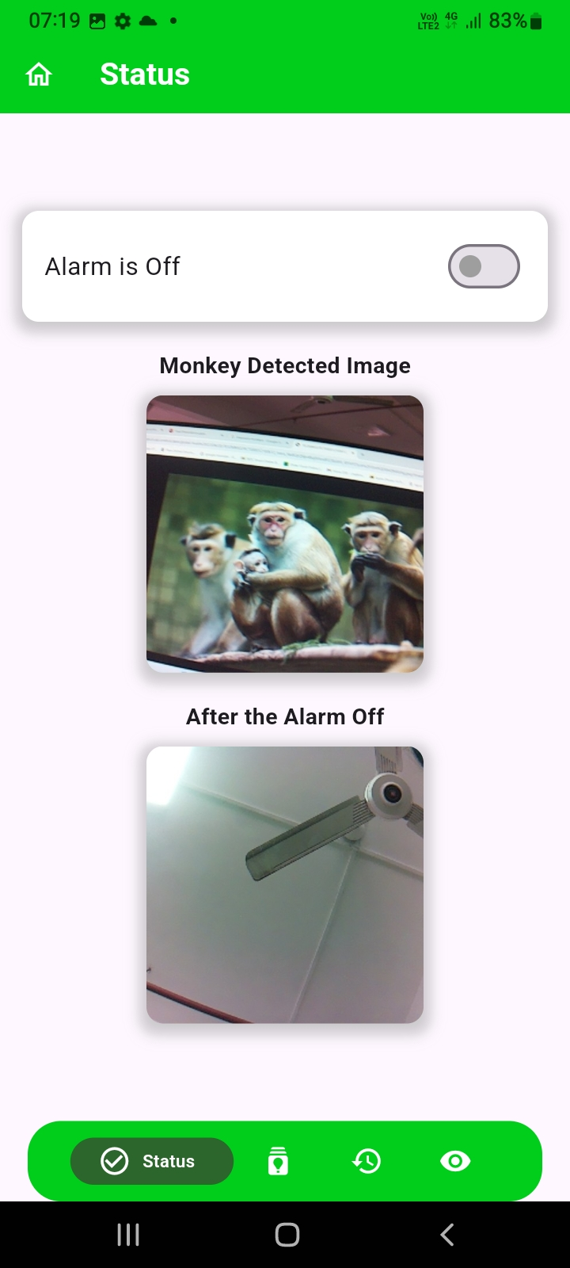
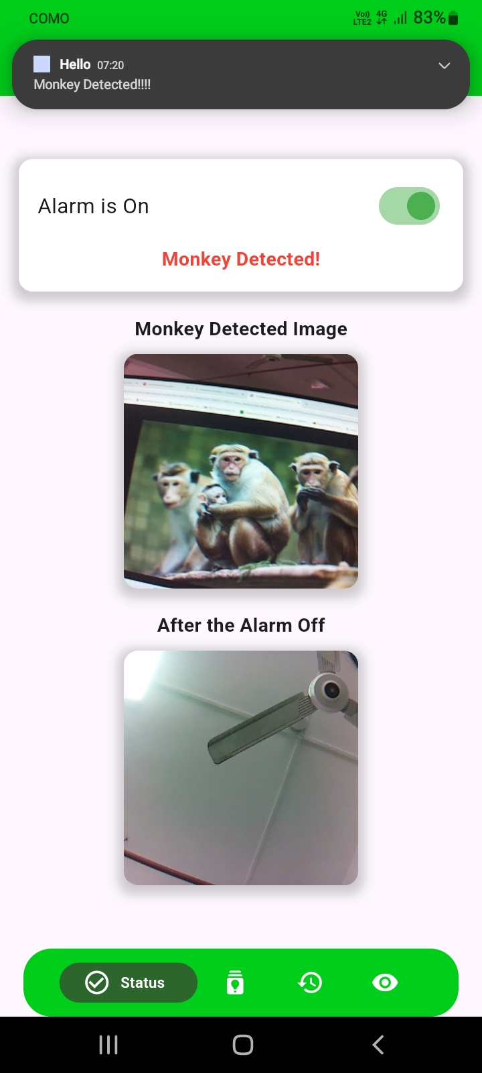
Minuscule Pest Detection Application

Slide 21

Macaque Monkey Prevalence and Behavior Patterns Identification
Senanayake P.M.

Slide 22
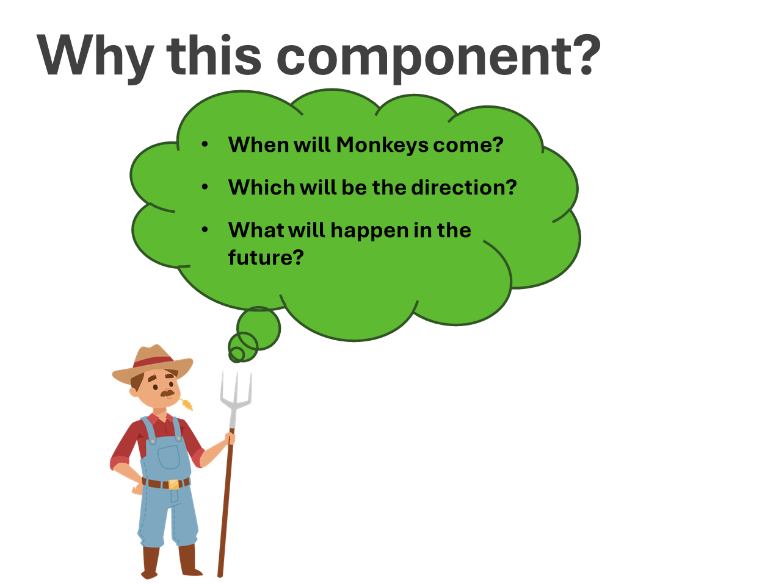
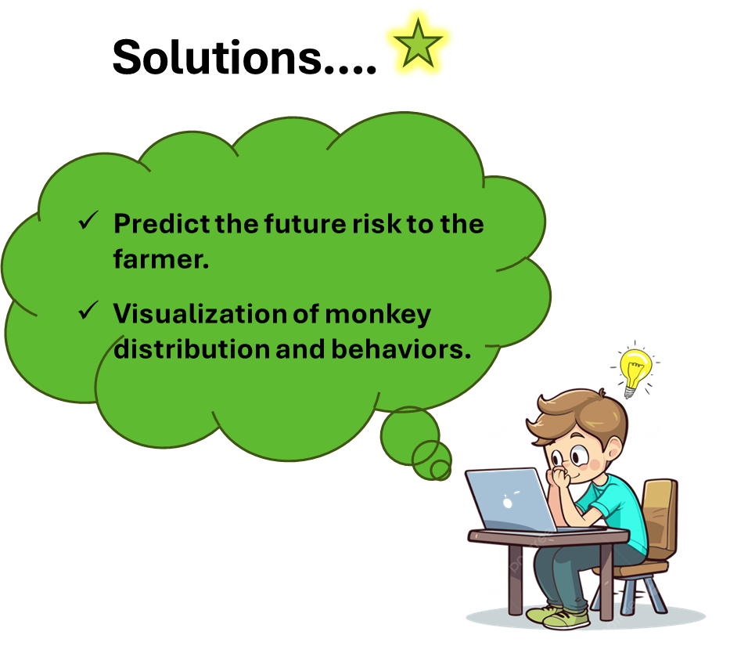

Slide 23
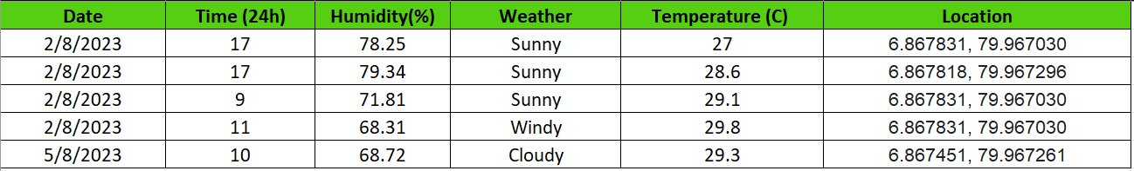
Data Collection
Coordinates | Mic Station
6.867831, 79.967030 | MIC 01
6.867818, 79.967296 | MIC 02
6.867818, 79.967501 | MIC 03
6.867690, 79.967585 | MIC 04
6.867536, 79.967425 | MIC 05
6.867451, 79.967261 | MIC 06
6.867603, 79.967033 | MIC 07
Field Location - Hokandara South

Slide 24
Testing & Results
Time Series Models
No. | Model | Mean Squared Error
1 | ARIMA | 0.81
2 | LSTM | 1.41
Classification Models
No. | Model | Avg. Accuracy
1 | Decision Tree | 0.60
2 | Random Forest | 0.56
3 | RNN | 0.78

Slide 25
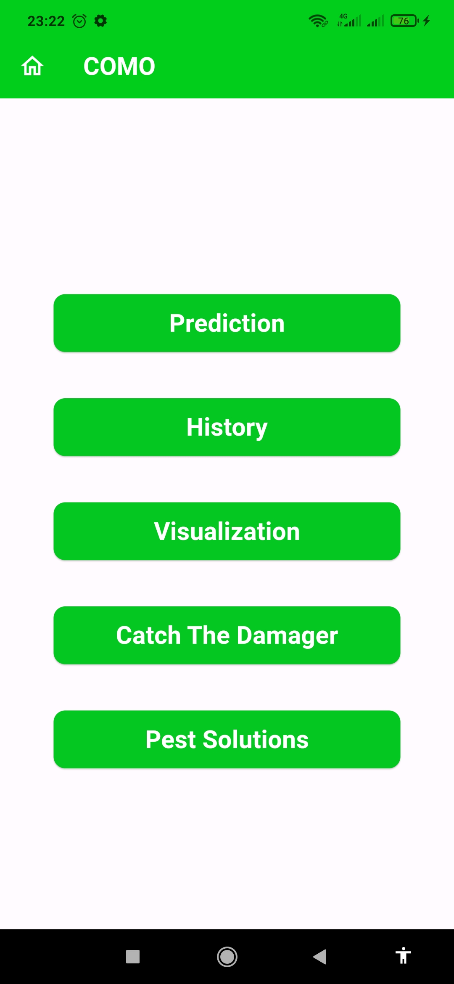
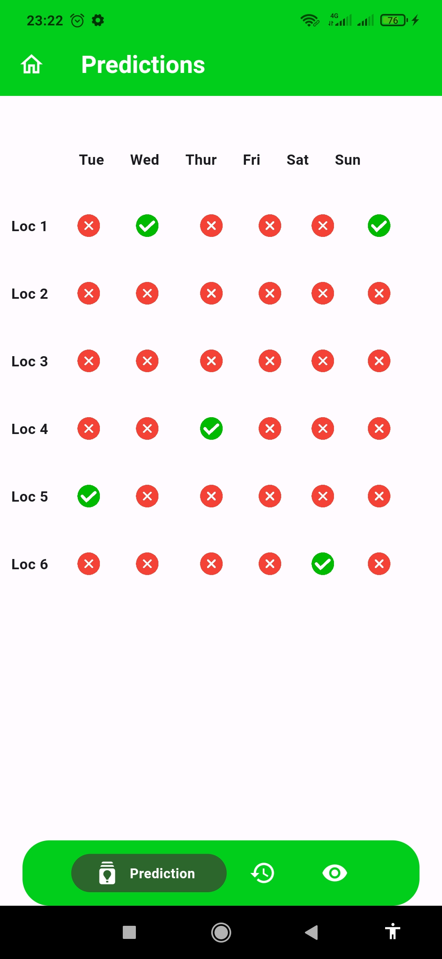
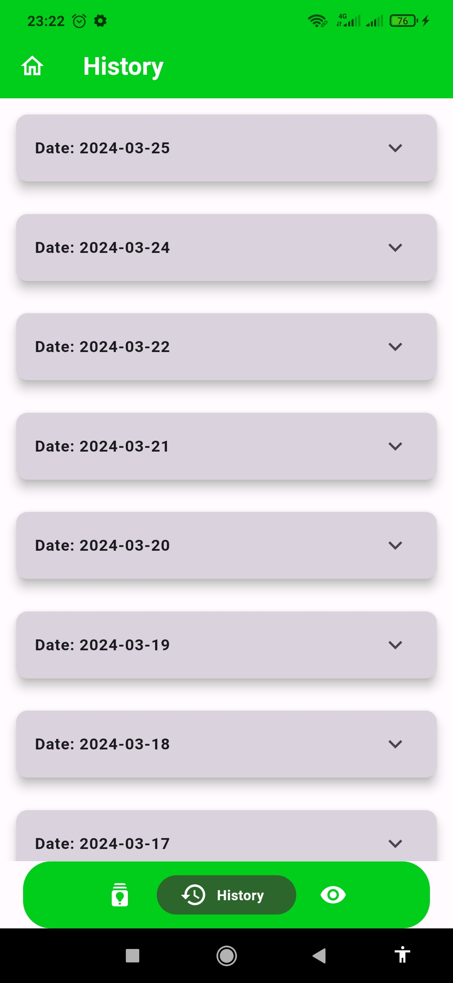
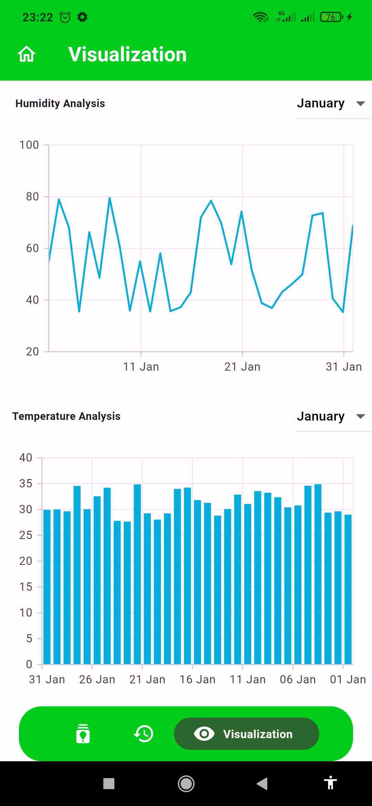
Macaque Monkey Prevalence and Behavior Patterns Identification

Slide 26

Minuscule Pest Detection
Withanage P.W.E.L. (IT20600334)

Slide 27
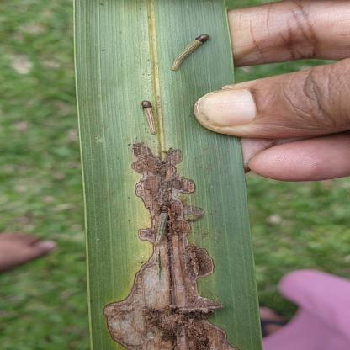
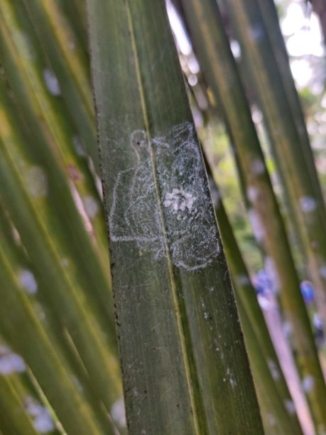

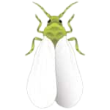
Minuscule Pest Detection
Dataset (Initial Stage of the pest attack)
Coconut Caterpillar
Whitefly

Slide 28
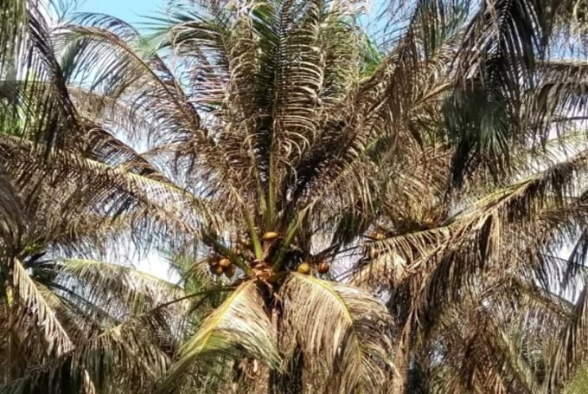
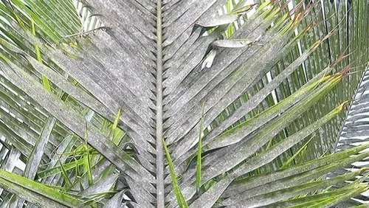
Minuscule Pest Detection
Growth of the Pest Attack
Coconut Caterpillar
Whitefly

Slide 29
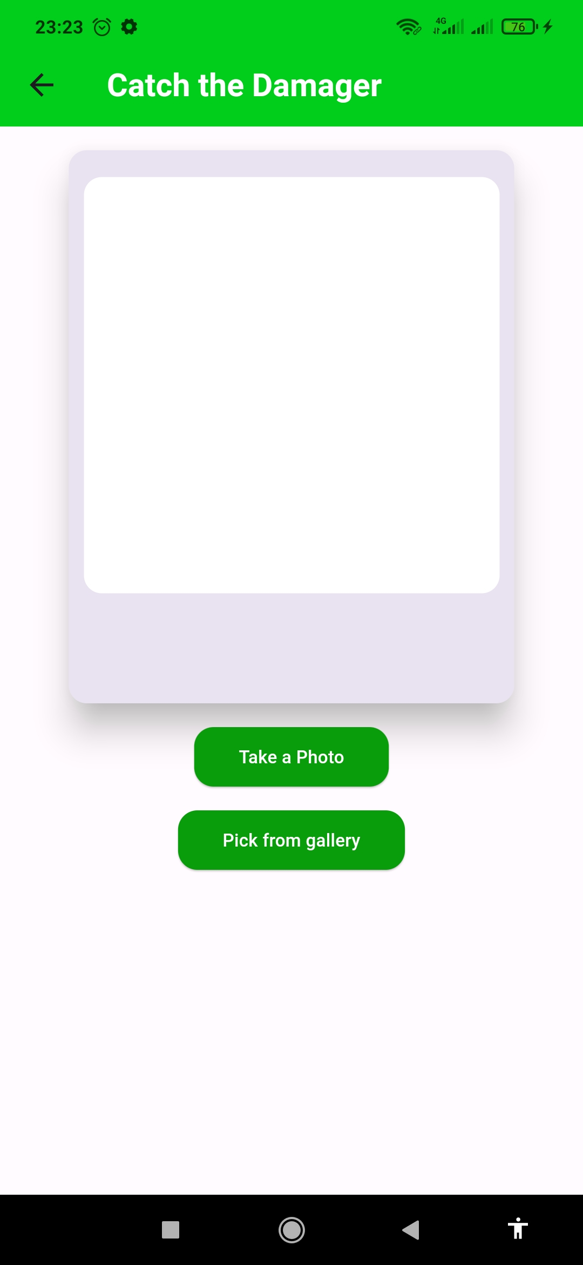
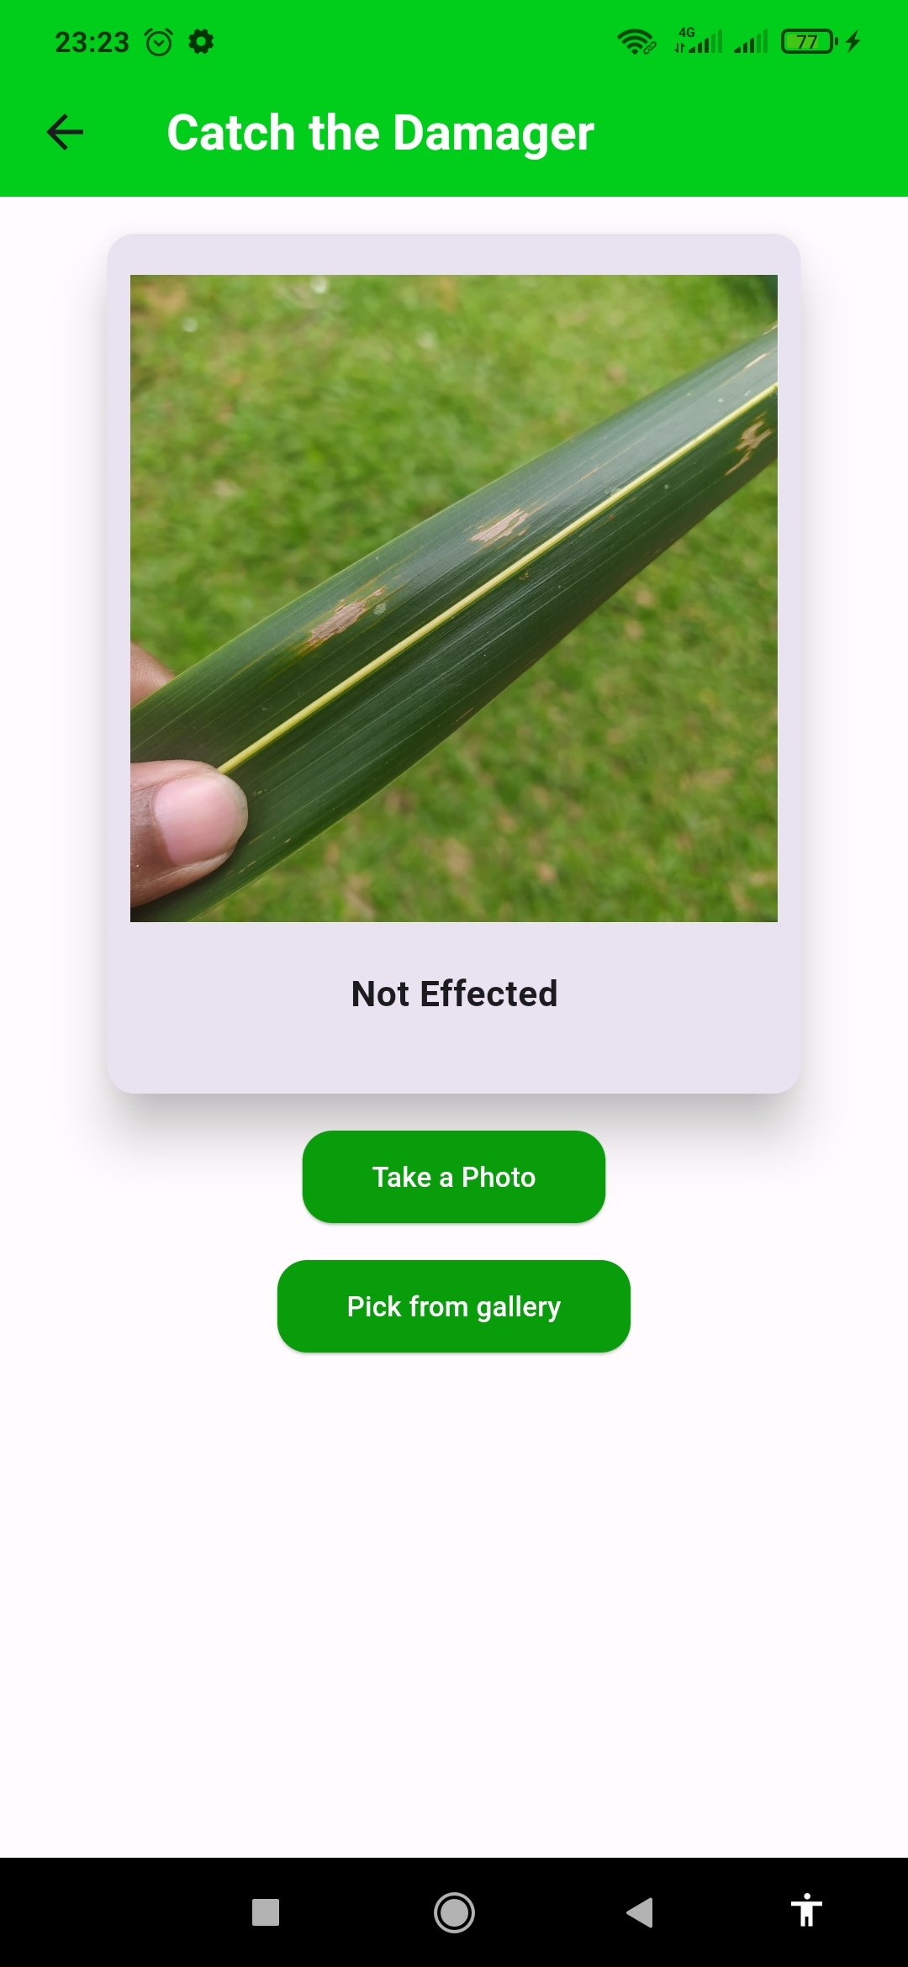
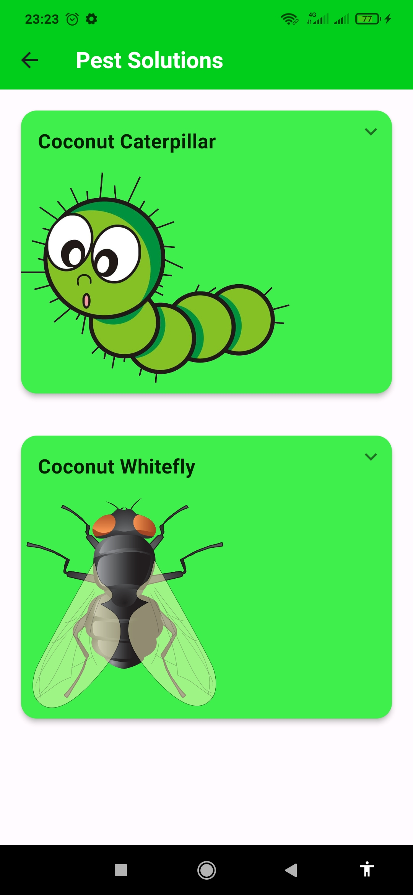
Minuscule Pest Detection Application

Slide 30

Testing & Results
Pretrained Model Performance
Pretrained Model | Avg. Accuracy | Total Parameters | Avg Pred. Time(s) | Size (MB)
ResNet50 | 0.62 | 24112513 | 1.2 | 91.92
VGG16 | 0.98 | 14846273 | 1.0 | 56.63
MobileNetV2 | 0.98 | 2652226 | 1.2 | 10.12
DenseNet121 | 0.78 | 7300161 | 3.2 | 27.85
InceptionV3 | 0.98 | 22327585 | 2.4 | 85.17

Slide 31
COMMERCIALIZATION

Slide 32
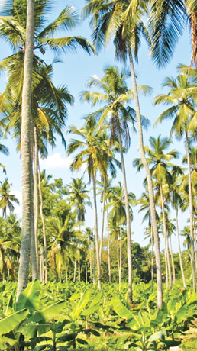
TARGET :
It covers an extent of 440,640 ha whilst the major coconut growing areas are Kurunegala and Puttalam districts in the North-Western Province (NWP) and Gampaha district in the Western Province constituting the Coconut Triangle, totaling 224,467 ha (50.9 %) of the total coconut growing area.
Wet Zone
Coconut
Farmers
The districts include Colombo, Kurunegala, and Puttalam. The reason for the name 'coconut triangle' is the geographical position of these three districts on the Sri Lankan map. The specialty of this area is the climate which belongs to the dry and intermediate climatic zones that ideally fit the coconut plantation.

Slide 33
Offering Packages
Basic
$0
Real Time Detection
Attack Alerts
Limited Predications
Limited Minuscule Detections
SIGN UP
Premium
$1.99
Real time Detection
Attack Alerts
Unlimited Predictions
Unlimited Minuscule Detections
SIGN UP

Slide 34

Thank You!

